Slide 1
Data Analysis
January 2015
Mike Farrell
5-Jan-15

Slide 2
Agenda
Summary Stats
ECS
Counts
MTTR
ECAP
Counts
MTTR
Sev 1 MTTR

Slide 3
Summary Stats
Incident count reduction
ECS 50%
ECAP +190%
Combined 26%
P1 MTTR (December)
ECS 2:21
ECAP 1:24
Combined 2:09
P1 Count (December)
ECS 12
ECAP 3
Combined 15
P2-P4 MTTR reduction
ECS
P2 52%
P3 66%
P4 45%
ECAP
P2 67%
P3 66%
P4 34%
Combined
P2 55%
P3 69%
P4 62%

Slide 4
GIS Quarterly Incident Counts
Backup, Enquiry, BPPM excluded
Notes:
ECS volume change = 50% reduction
ECAP volume change = 190% increase
Overall volume change = 26% reduction

Slide 5
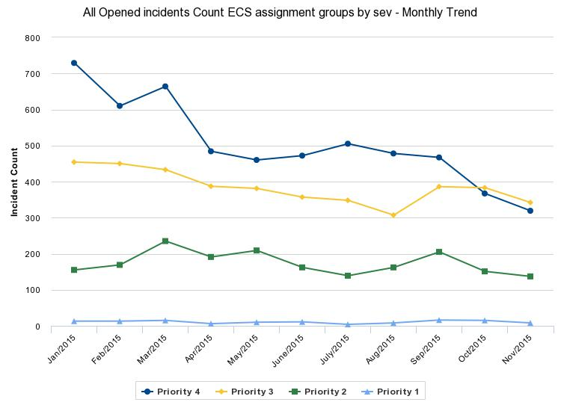
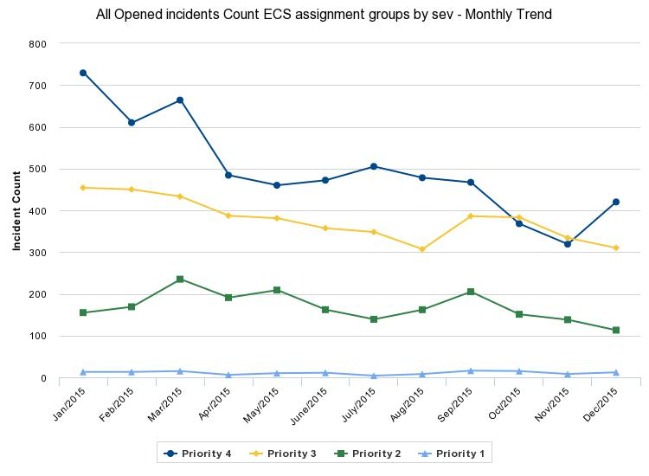
ECS Incident count
By priority without backup, enquiry or BPPM
Notes:
Sev 4’s jumped by 100
93 tickets for one incident related to a PAC file problem for Gaithersburg clients.

Slide 6
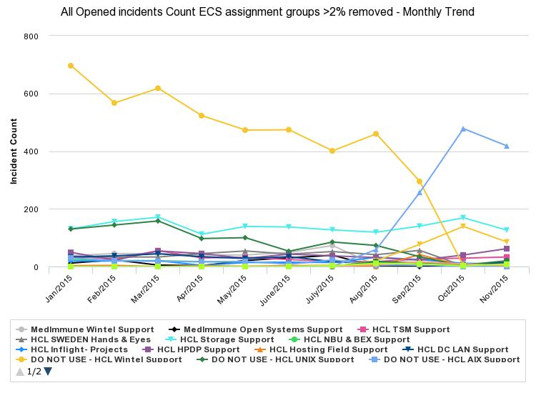
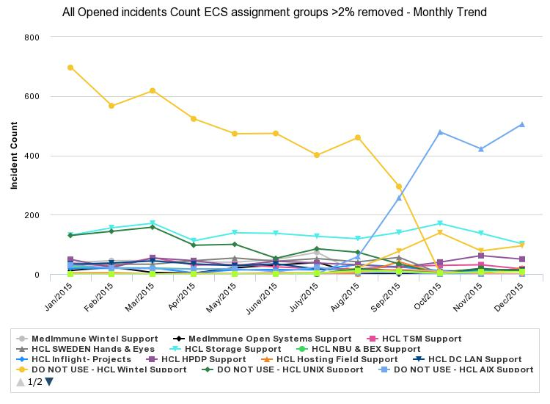
ECS Incident count
By closing assignment group without backup, enquiry or BPPM

Slide 7
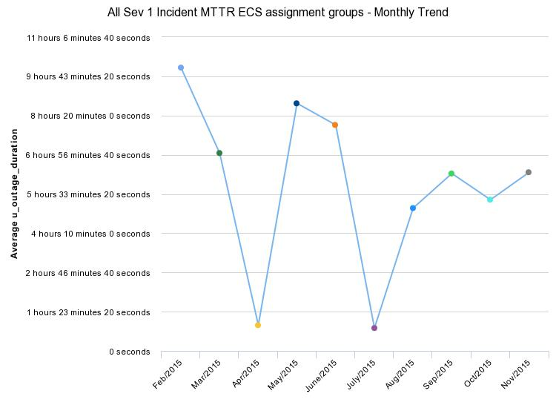
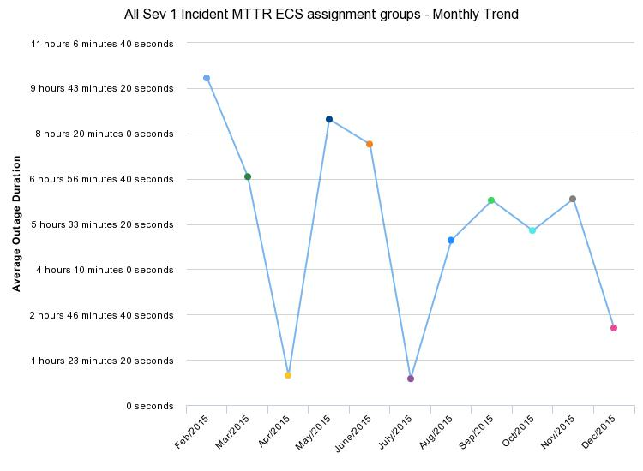
ECS SEV 1 MTTR

Slide 8
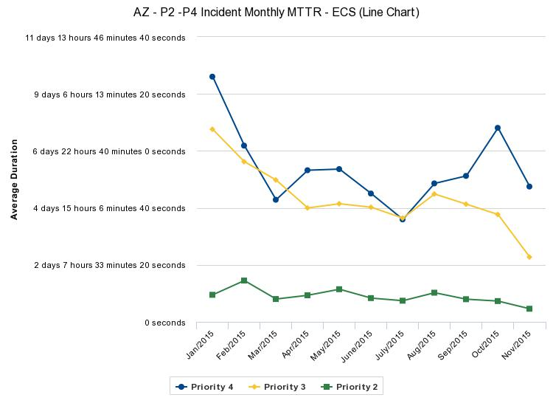
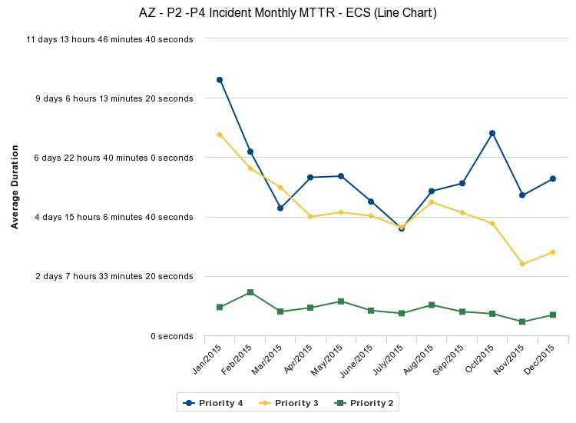
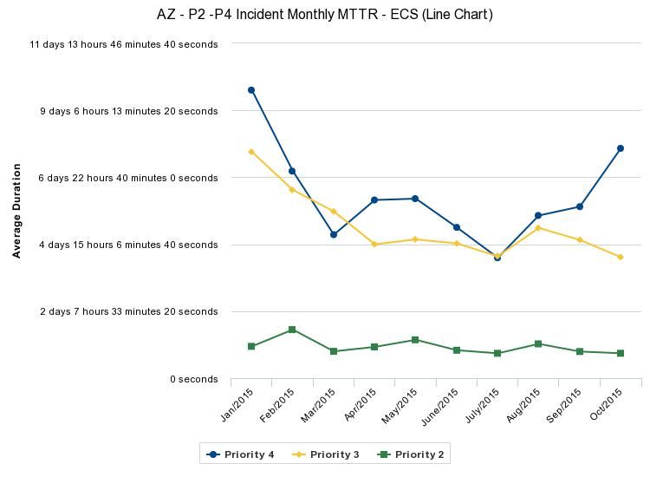
ECS P2-P4 MTTR

Slide 9
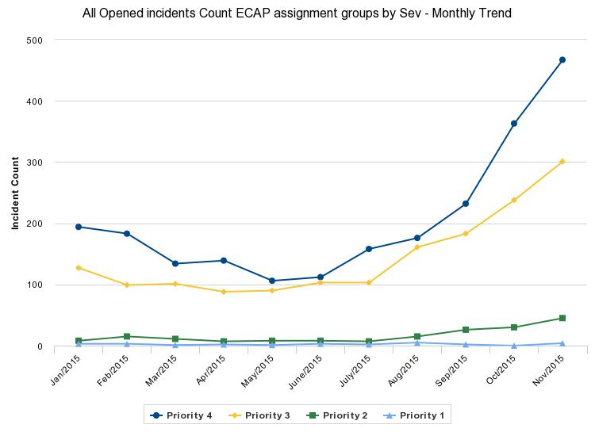
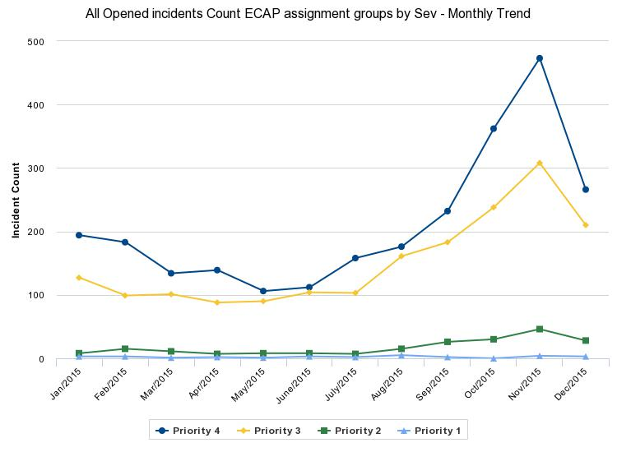
ECAP Incident count
By priority without backup, enquiry or BPPM
Notes:
Total down over 300 from November 831 to 507

Slide 10
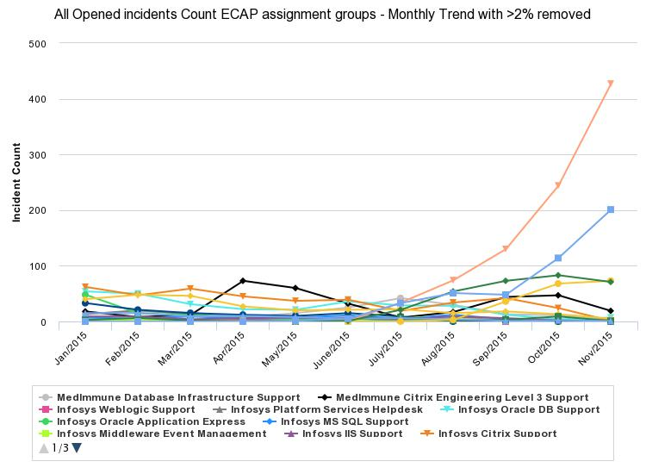
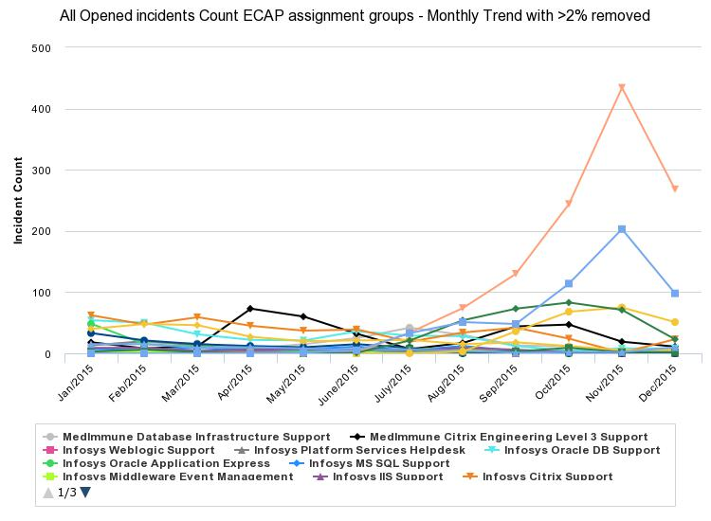
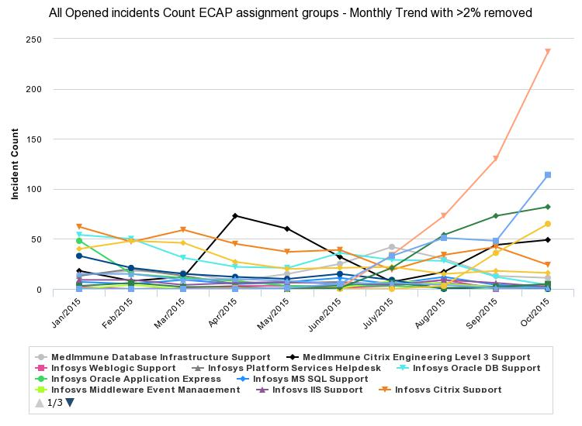
ECAP Incident count
By closing assignment group without backup, enquiry or BPPM
Notes:
Oracle is pink, Citrix is blue, green I smiddleware

Slide 11
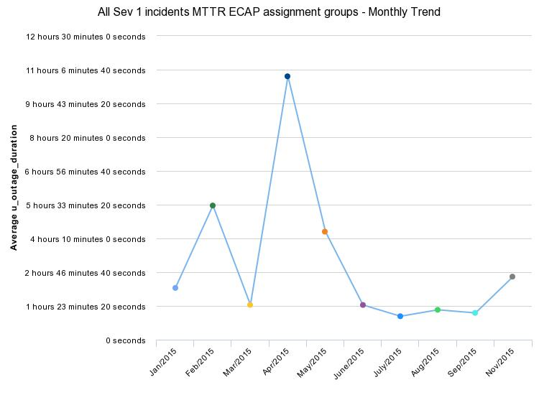
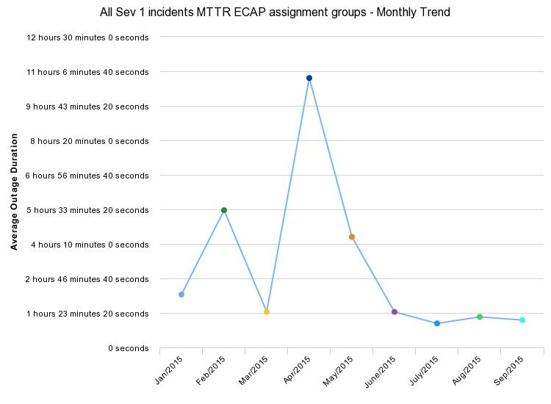
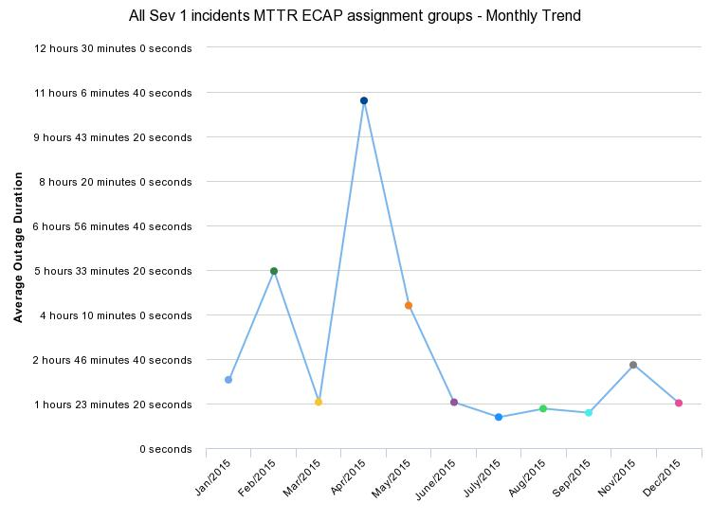
ECAP P1 MTTR
Notes:
2:35 for November

Slide 12
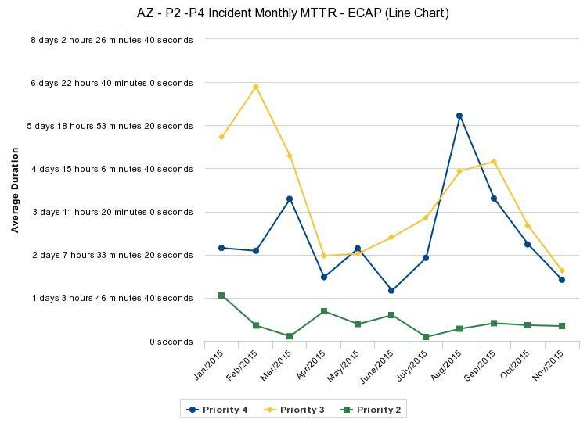
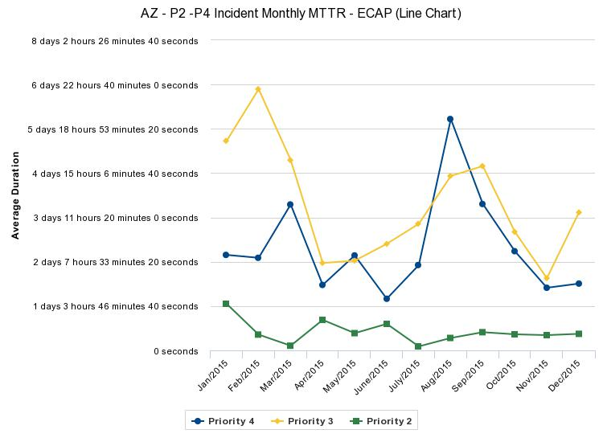
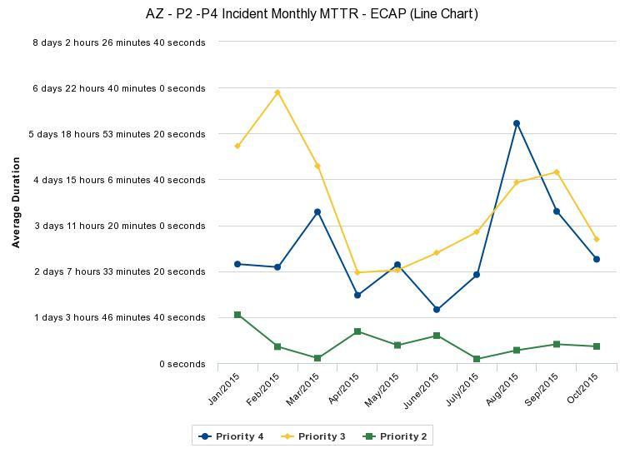
ECAP P2-P4 MTTR

Slide 13
ECS P1 stats from 2015
Resolution times
By Month | total | Percent resolved in 4 hours or less |  | By Group | total | Percent resolved in 4 hours or less | Percent 3 hours or less
Jan | 12 | 75% |  | AZ ECS - Backup and Recovery Support | 1 | 100% | 0%
Feb | 12 | 50% |  | AZ ECS - Unix Support | 6 | 50% | 33%
Mar | 11 | 55% |  | AZ ECS - Wintel/VMWare/Cloud Support | 11 | 100% | 73%
Apr | 4 | 50% |  | DO NOT USE - HCL UNIX Support | 14 | 57% | 36%
May | 9 | 67% |  | DO NOT USE - HCL Wintel Support | 40 | 70% | 58%
June | 8 | 63% |  | HCL DC LAN Support | 1 | 0% | 0%
July | 4 | 75% |  | HCL HPDP Support | 4 | 75% | 50%
Aug | 8 | 88% |  | HCL Inflight- Projects | 6 | 17% | 17%
Sep | 7 | 43% |  | HCL LEGATO Support | 1 | 0% | 0%
Oct | 13 | 69% |  | HCL Storage Support | 6 | 17% | 17%
Nov | 6 | 50% |  | HCL TSM Support | 2 | 50% | 0%
dec | 2 | 50% |  | MedImmune Storage Support | 1 | 0% | 0%
Total | 96 | 63% |  | MedImmune Wintel Support | 3 | 67% | 67%
 |  |  |  |  | 96 | 63% | 46%

Slide 14
P1 observations and recommendation
GIS involved in approximately ½ of P1s.
GIS closes approximately 1/3 of P1s
P1 extended length drivers
Restores
Parts
Networks
High number of systems affected
ECAP P1 MTTR lower due to limited impact of extended length drivers
Ticket transfers do not directly correlate to long resolve times
HCL UNIX and Inflight have poorest MTTR record for GIS
Strengthen IM, and post mortem reviews/actions

Slide 15
Appendix
Analysis of 2015 P1 INC assignment trails
345 incidents
168 with GIS involvement
124 incs closed by GIS
1029 distinct assignments to groups
381 assignments to GIS

